Slide 1
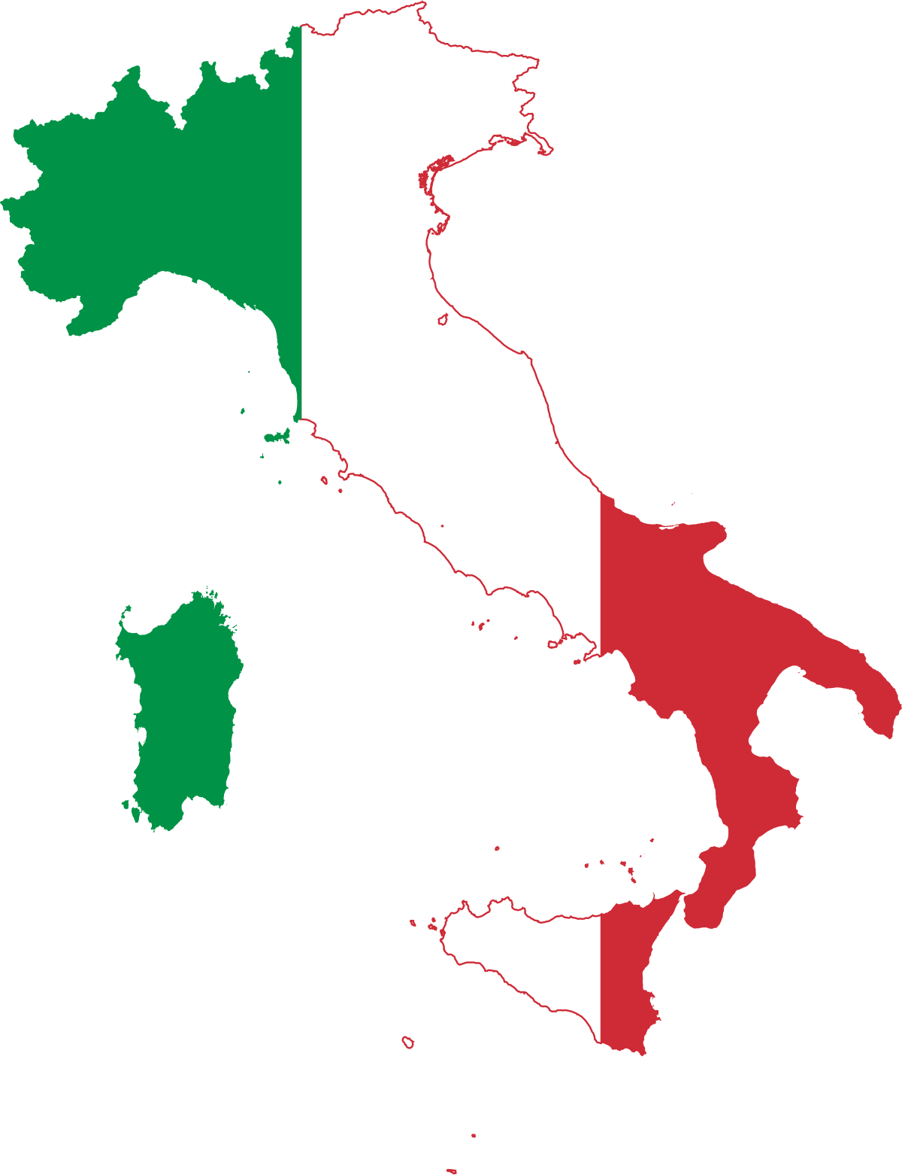
Italy
Notes:
Last updated: 09-05-22

Slide 2
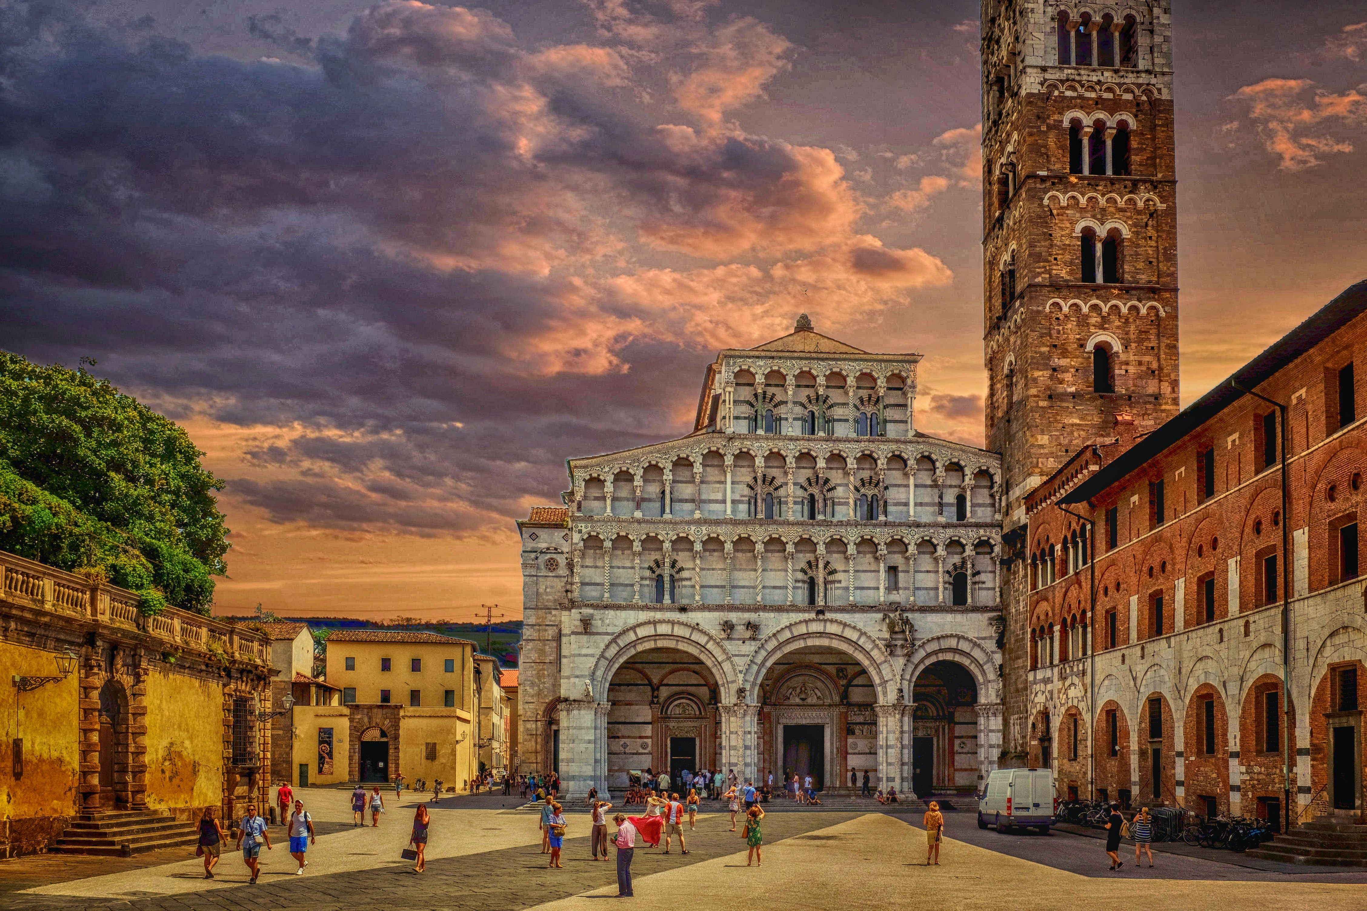
The population of Italy is 58,870,762 and is decreasing slowly.
Notes:
What information would be useful for visitors to know? Some of this information might come from other pages your group has made.

Slide 3
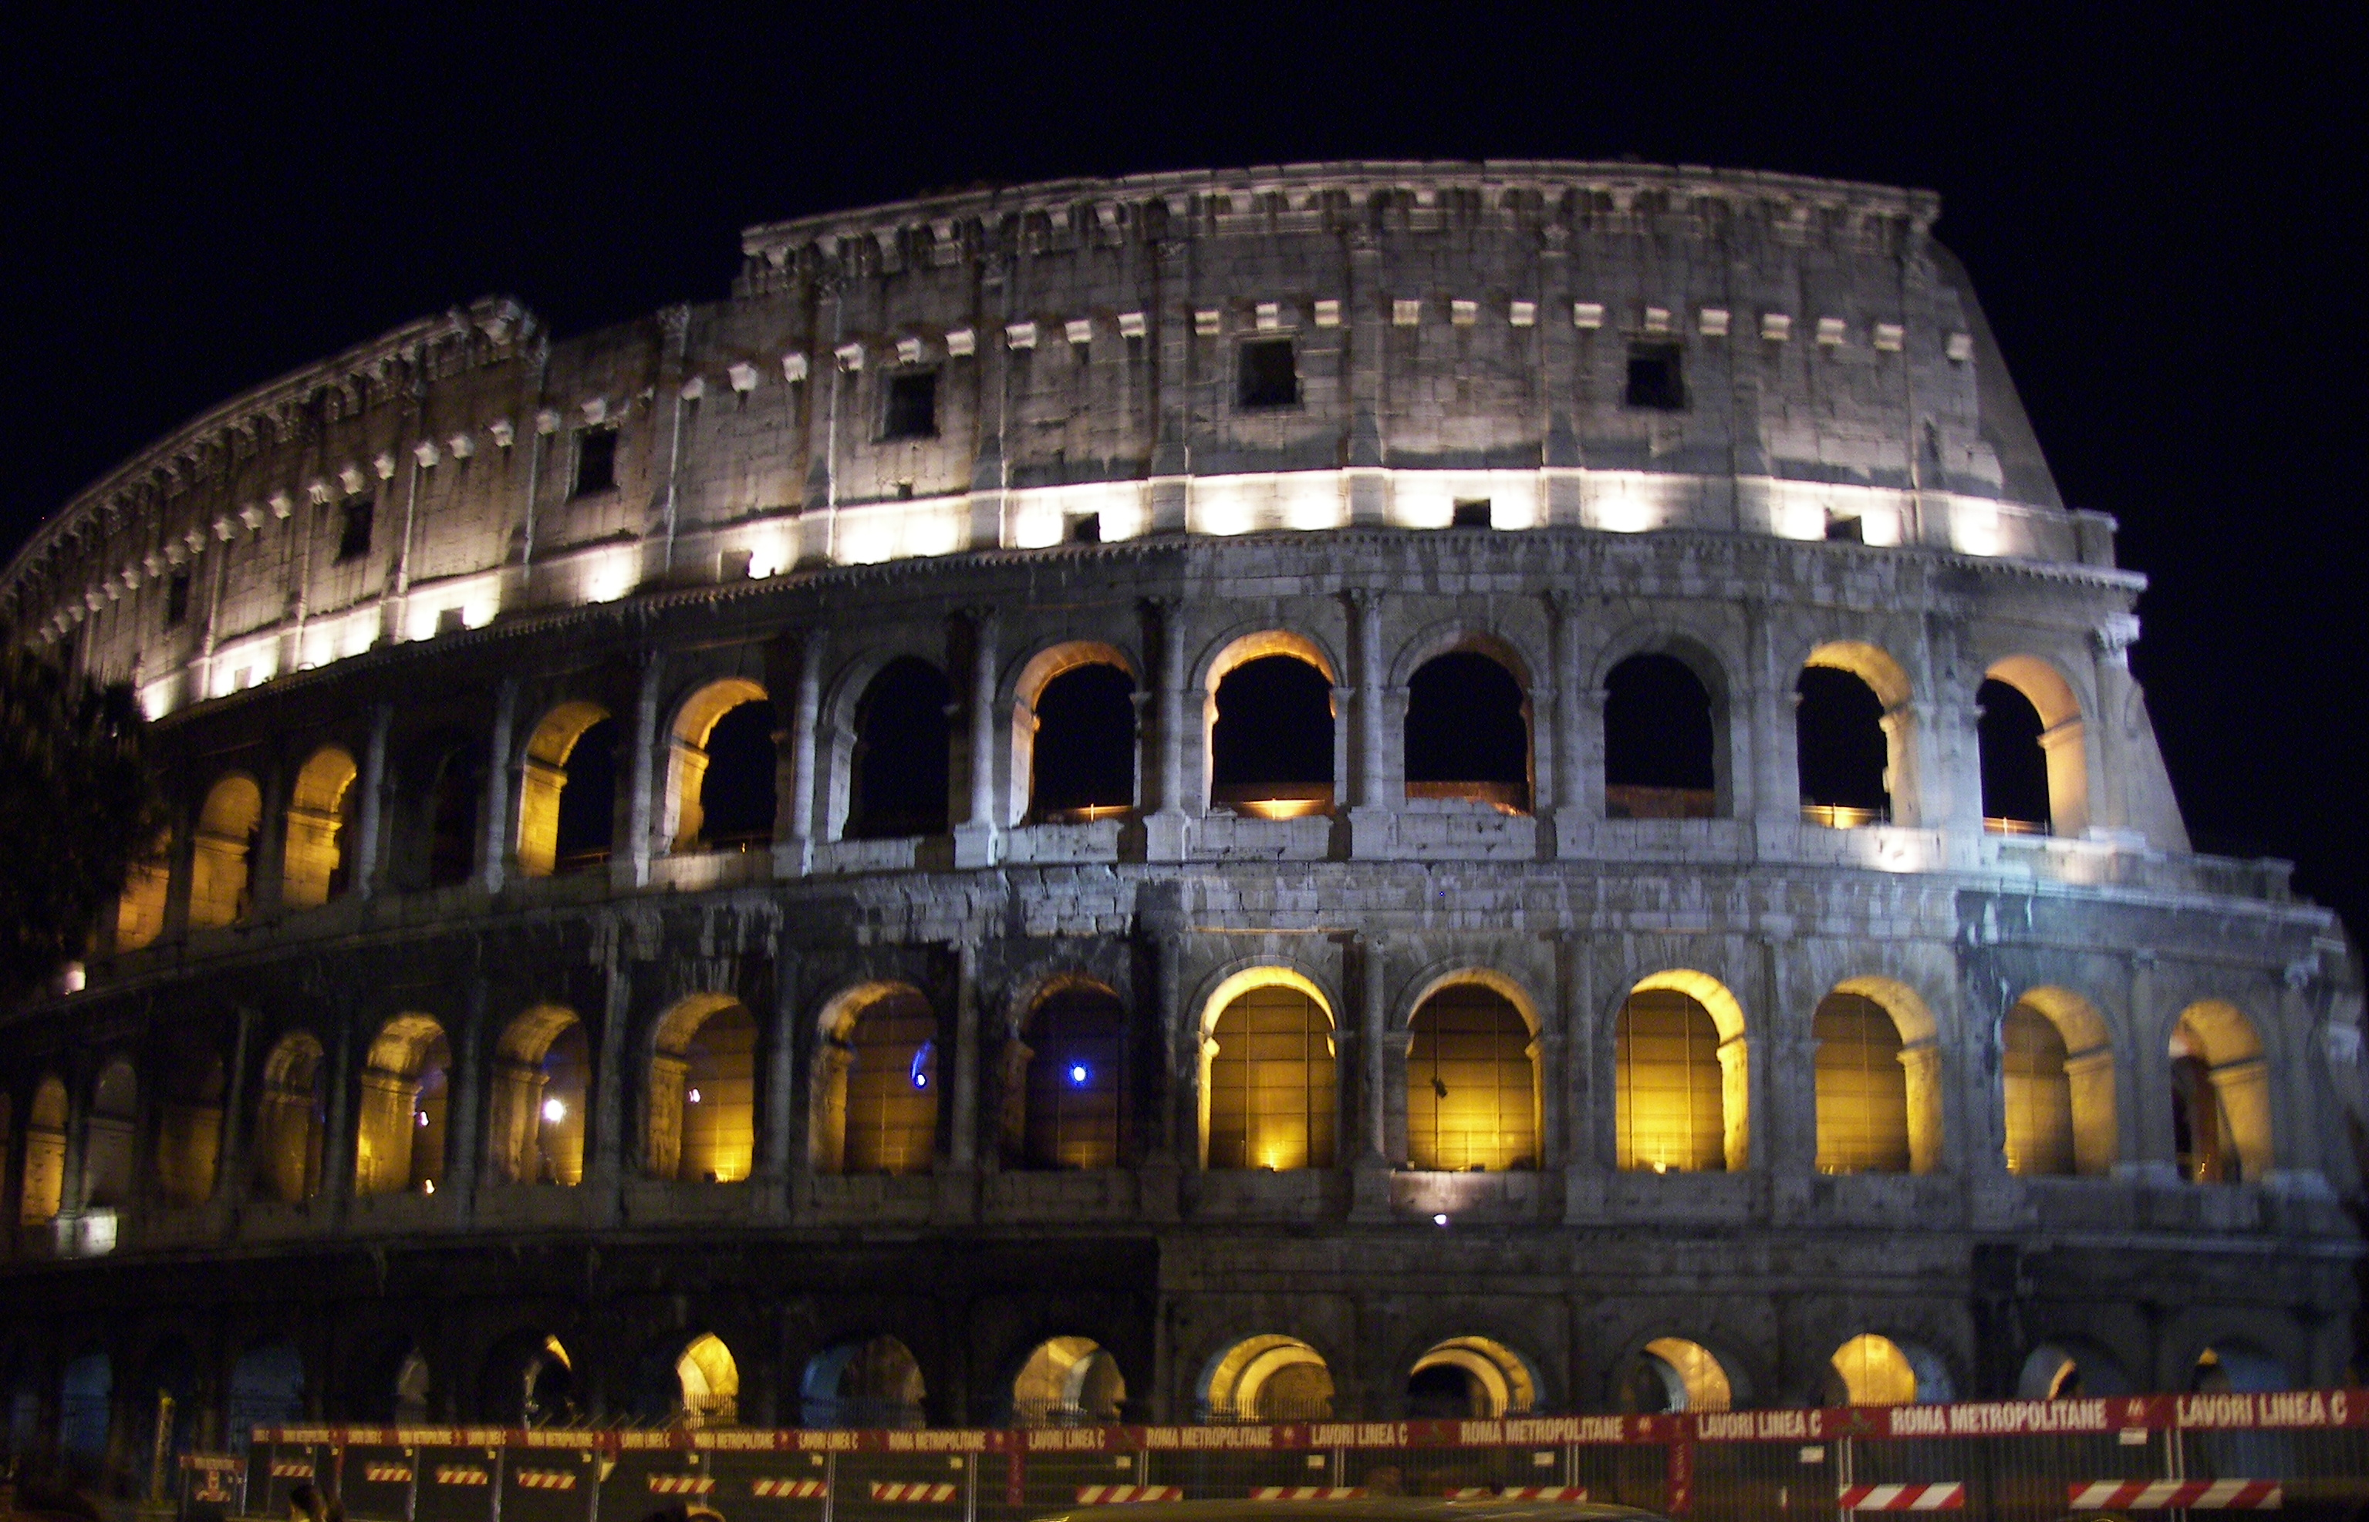
The main cities in Italy are Rome, Milan and Venice.
Notes:
What are the countries main cities? Which is the capital?

Slide 4
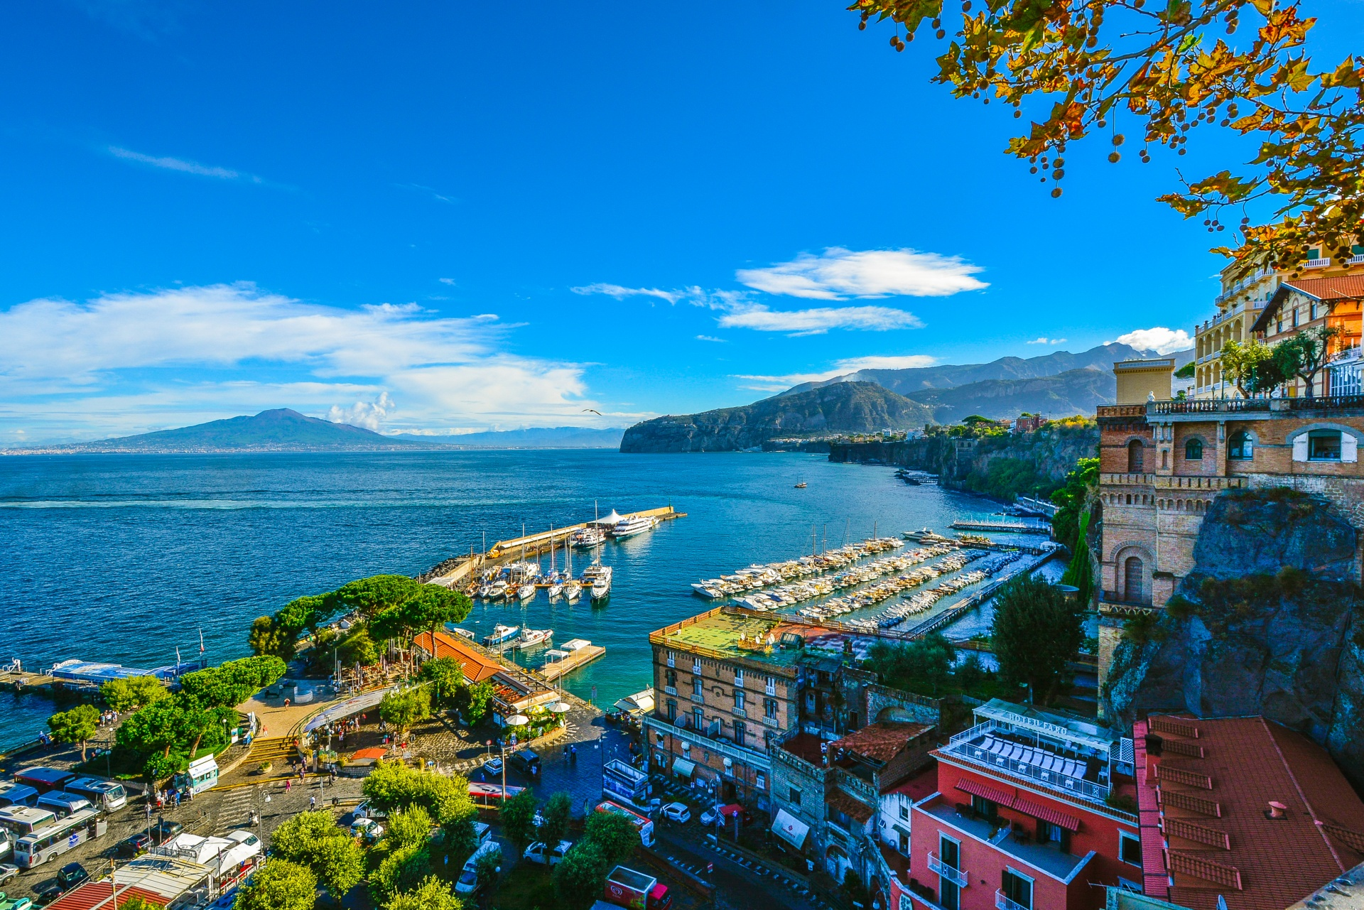
One of the most famous visitor attractions in Italy is the Colosseum in Rome.
Notes:
What are some of the attractions a visitor might want to visit? What information can you include about these attractions?

Slide 5
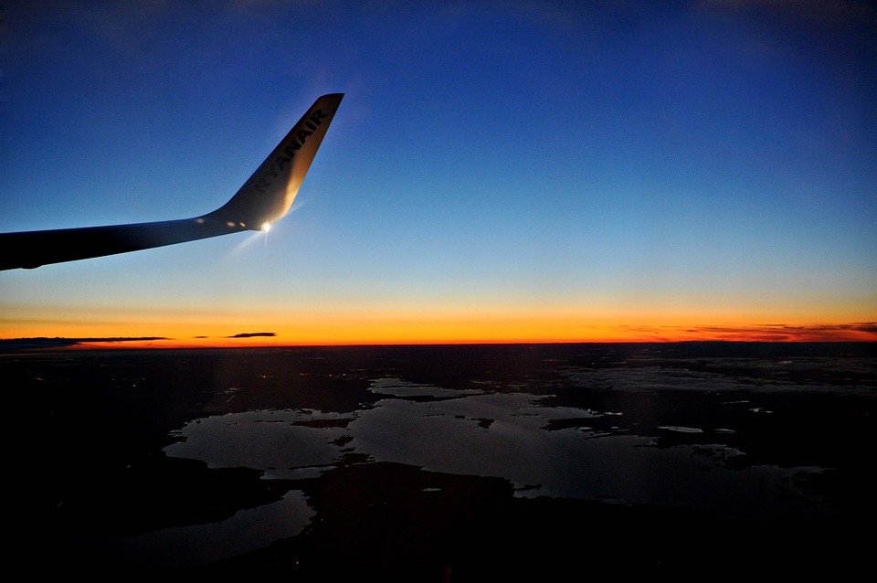
The best way to get to Italy from the UK is by plane which can take around 4h 40m.
Notes:
How could someone get to the country from your country? Think about the different transportation options, you might include driving, flying, and sailing?

